Slide 1
UNIVERSE OR MULTIVERSE
Is our galaxy alone. Explain
What causes matter to speed up as it gets farther away?
What is theorized to have occurred about 14 billion years ago?
What theory says that at the smallest level the universe is made up of multiple dimensions
If there are multiple universes than what is likely to exist?

Slide 2
VOCABULARY UNIVERSE
Astronomy Galaxy Astronomical Unit
Star Light Year Electromagnetic Spectrum
Doppler Effect Nebula Absolute Magnitude
Nova Neutron Star Apparent Magnitude
Main Sequence HR Diagram Constellation
Quasar Cosmology Cosmic Background Radiation
Big Bang Theory Dark Matter

Slide 3
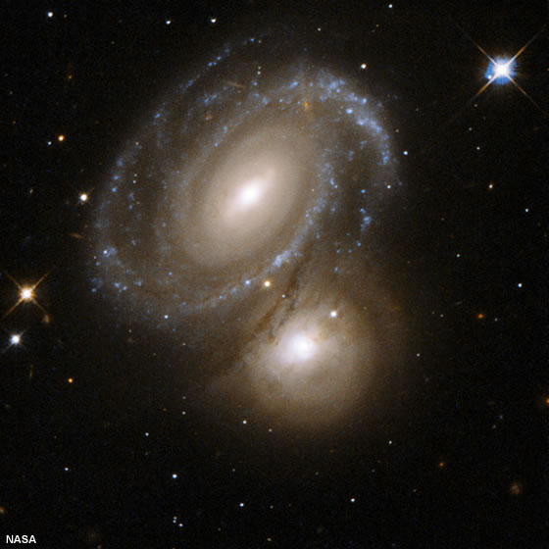
THE UNIVERSE

Slide 4
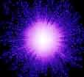
Cosmology is the study of the origin, properties, and evolution of the universe.
Most astronomers agree that the universe began about 14 billion years ago.
The most accepted theory on the creation of the universe is called the “Big Bang”.
The Big Bang states that all the matter in the universe was contained in a ball, called the Yelm, about the size of a period at the end of a sentence. The Yelm exploded sending matter in all directions throughout the universe.

Slide 5
The Big Bang suggests that the universe is constantly expanding.
Another theory on the creation of the universe is the Steady State Theory. This theory states that as matter moves outward, new matter replaces it at the center.
A third theory, the Oscillating Big Bang, states that some time in the future gravity will cause all the matter to pull back to a center point and the big bang will happen again.

Slide 6
The universe can be broken down into smaller units known as galaxies.
It is estimated that there are 100’s of millions of galaxies in the universe.

Slide 7
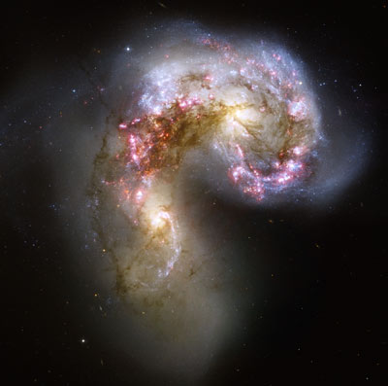
There are three types of galaxies, each having different characteristics.
The first type is an irregular galaxy.
These galaxies contain large amounts of gas, mostly young hot stars and have no definite shape.
These galaxies are thought to be young, newly forming galaxies

Slide 8
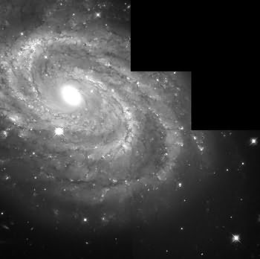
The next type is the spiral galaxy. The Milky Way is a spiral galaxy. There are two types of spiral galaxies.
A Barred Spiral
Armed Spiral
Spiral galaxies have clouds of gas at their center with young hot stars also found there. They also find many middle age and a few older stars as well.

Slide 9
The final type of galaxy is the Elliptical galaxy.
The elliptical galaxy is dimmer than the other two. There is very little dust or gas present and most of the stars are cooler older stars. These are thought to be the oldest galaxies.

Slide 10
The distance between stars and galaxies is measured in light years.
A light year is the distance light can travel in one year, about 9.4 trillion km. ( 6 trillion miles )
The closest star to our own sun is 4.2 light years away.

Slide 11
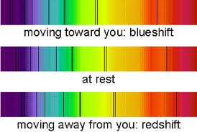
The theory of the big bang came about with the discoveries of Edwin Hubble.
Hubble discovered that the spectra of galaxies, except the few nearest us, showed a shift in light toward the red end of the spectrum.
By examining the amount of red shift he determined how fast the galaxy was moving. Galaxies farther away showed a greater shift, therefore were moving faster.

Slide 12
Hubbles findings led to the idea that the universe is expanding and helps to supply evidence of the big bang.
In 1965 scientist used radio telescopes to detect cosmic background radiation. This low level energy was found to be evenly distributed throughout the universe.
At the time of the big bang this energy would have been very hot and would have cooled to a great extent by now.
This energy has a temperature of -270° C only 3° above absolute zero.
Maps of background radiation shows areas of temperature fluctuations called ripples.
These ripples have led scientist to believe that the universe contains more mass and energy than they can currently detect.

Slide 13
The known visible matter in the universe only makes up 4% of the universe.
23% of the universe is made up of a matter that does not give off light. This is called dark matter and has been detected by its gravitational attraction.
73% of the universe is believed to be made up of dark energy, a force that opposes gravity.
Recent evidence suggests that the galaxies are farther from Earth than current theory would indicate. Scientist suggest that this dark energy is pushing galaxies apart. This may also explain why these distant galaxies are accelterating.

