Slide 1
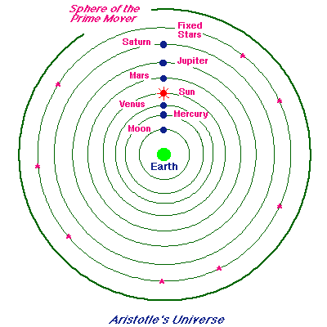
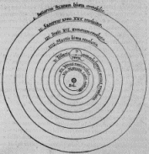
MODELS OF THE SOLAR SYSTEM
PTOLEMY VS. COPERNICUS

Slide 2
OBJECTIVES:
Compare the models of the universe developed by Ptolemy and Copernicus.
Summarize Kepler’s three laws of planetary motion.
Describe how Newton explained Kepler’s law of motion.

Slide 3
ARISTOTLE
About 2000 years ago, Aristotle, a Greek philosopher, suggested an Earth-centered or geocentric model of the solar system.
His model had the sun, stars and planets revolving around the earth.
This model did not explain why some planets appeared to move backward in the sky relative to the stars, a pattern called retrograde motion.

Slide 4
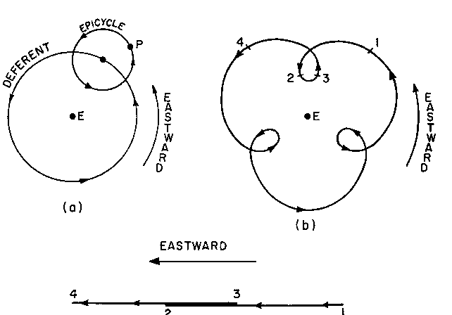
PTOLEMY
Around 130 BC the Greek philosopher, Claudius Ptolomaeus, better known as Ptolemy, changed the Aristotle model.
Ptolemy thought that the planets moved in small circles called epicycles as they revolved in larger circles around Earth.
Planet
Retrograde
Earth

Slide 5
COPERNICUS
In 1543 a Polish doctor and lawyer named Nicolaus Copernicus proposed a sun, or heliocentric, model.
In this model the planets moved around the sun in the same direction but at different speeds and distances from the sun.
Earth and moon
Sun

Slide 6
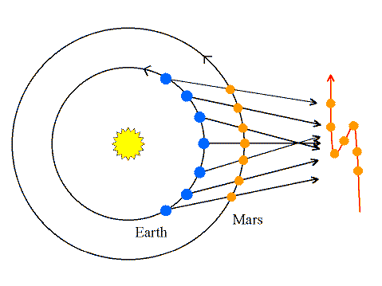
Copernicus said that fast moving planets passed the slow moving planets. Therefore planets that were slower than Earth appeared to move backward or retrograde.
Actual motion
Apparent motion from Earth

Slide 7
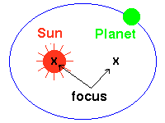
JOHANNES KEPLER
Kepler was an assistant to a Danish astronomer/mathematician named Tycho Brahe. After Brahe’s death, Kepler discovered patterns in Tycho’s observations. These patterns led Kepler to develop three laws that explained planetary motion.
Law of Ellipses
Kepler’s first law states that each planet orbits the sun in a path called an ellipse, not a circle.
The shape of the orbit is determined by two focus points. The sun is at one point, there is no object at the second.

Slide 8
Ellipses can vary in shape. Some ellipses are more elongated than others. The difference in this shape is called eccentricity.
More eccentric
A
X
X
B
Eccentricity is determined by dividing the distance between the foci (A), by the length of the major axis (B).

Slide 9
Law of Equal Areas
The second law describes the speed of objects at different points in their orbits. The area through which an object or planet sweeps over a given time will be equal.
Fast part of orbit
10 days
10 days
Slow part of orbit
Equal areas

Slide 10
Law of Periods
Kepler’s third law describes the relationship between the average distance of a planet from the sun and the orbital period (length of revolution) of the planet.
This means that the cube of the average distance (a) is equal to the square of the period of revolution (p).
Formula: a³ = p²
Jupiter takes 11.9 Earth years to revolve around the sun (P). The square of 11.9 is 142.
You would then take the cube root of 142 or 5.2. The distance from the sun is then 5.2 A.U.

Slide 11
Newton’s explanation of Kepler’s laws
Newton’s first law states that an object in motion remains in motion unless acted upon by an outside force.
This resistance to change in speed or motion he called inertia.
Since the planets do not follow straight lines, an outside force must cause them to curve. He called this force gravity and that this force exists between any two objects in the universe.
While gravity pulls an object towards the sun, inertia keeps it moving in a straight line. The sum of these two motions is an ellipse.

