Slide 1
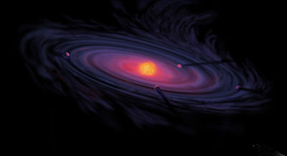
THE FORMATION OF THE SOLAR SYSTEM

Slide 2
OBJECTIVES:
Explain the nebular hypothesis of the origin of the solar system
Describe how the planets formed
Describe the formation of the land, the atmosphere, and the oceans on Earth.

Slide 3
In 1796, the French mathematician, Pierre-Simon, marquis de Laplace, introduced the hypothesis now known as the nebular hypothesis.
The hypothesis states that the sun and all the planets condensed at
the same time out of a rotating cloud of gas and dust called a nebula.

Slide 4
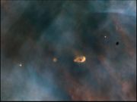
Almost 5 billion years ago, the amount of gravity near one of these clouds increased as a result of a nearby disturbance, possibly a super nova, causing the cloud to spin.
This is a protostar and solar system forming in the Orion Nebula.

Slide 5
Gravity increases in the nebula, pulling matter in toward the center.
When the temperature at the center reaches 10,000,000° C, hydrogen fusion begins
When fusion begins, a star is born.
Energy from collisions and pressure cause the center of the solar nebula
to become hotter and denser.

Slide 6
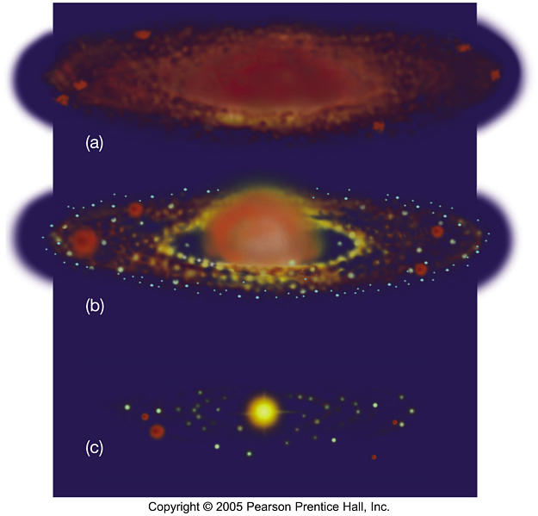
As the sun formed at the center, the planets were forming in the outer regions. Fig. b
Small bodies from which the planets originated, called planetesimals, collide and become larger bodies called protoplanets.
The protoplanets eventually became larger and condensed to form the planets and moons that orbit the planets. Fig. c

Slide 7
The features of a developing planet depend on the distance between the planet and the developing star.
Mercury, Venus, Earth and Mars all formed close to the sun. They contained large percentages of heavy elements such as iron and nickel.
These planets lost their less dense gases because of the temperatures close to the sun, the planets did not have enough gravity to hold the gases.
Today the inner planets all have solid surfaces that are similar to that of Earth.

Slide 8
The next four protoplanets became the outer planets Jupiter, Saturn, Uranus and Neptune.
These planets formed in the colder regions of the solar nebula far from the sun. At first thick layers of ice surrounded small cores of heavy elements.
Because of the intense heat and pressure in the planets interiors, the ices melted to form layers of liquids and gases.

Slide 9
When Earth first formed, it was very hot. Three sources of energy contributed to the high temperature on the new planet.
First, much of the energy was produced when the planetesimals that formed the planet collided with each other.
Second, the increasing weight of Earth’s outer layers compressed the inner layers which generated more energy.
Third, radioactive materials that emit high-energy particles were very abundant when Earth formed. When surrounding rocks absorbed these particle, the particles motion led to higher temperatures.
As denser materials sank to the center and less dense rose to the top, the earth formed three distinct layers in a process called differentiation.

Slide 10
As the solid earth cooled, less dense gas molecules such as hydrogen and helium, rose to the surface. Thus Earth’s original atmosphere was mostly hydrogen and helium.
Earth’s gravity was not strong enough to hold these gases.
As the earth continued to form, volcanic eruptions were much more frequent than today. These eruptions released large amounts of gases, mainly water vapor, carbon dioxide, nitrogen, methane, sulfur dioxide and ammonia. This process was known as outgassing and formed the new atmosphere.
These gases reacted with solar radiation to break down the ammonia into hydrogen and nitrogen. Most of the hydrogen escaped into space. Water vapor also broke down and the oxygen formed ozone which shielded the Earth from ultraviolet radiation.

Slide 11
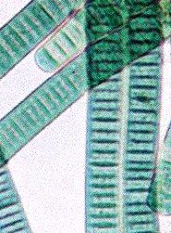
Cyanobacteria and small green plants that were able to survive the early atmosphere changed carbon dioxide in the atmosphere into oxygen. About 2 billion years ago the amount of oxygen reached todays levels.
The collision of comets with earth, put more water vapor into the atmosphere. As the earth cooled, the water vapor condensed to form rain.
The oceans affect earth’s atmosphere by dissolving carbon dioxide from the atmosphere. It is believed that Earth’s early climate was probably cooler than it is today.

