Slide 1
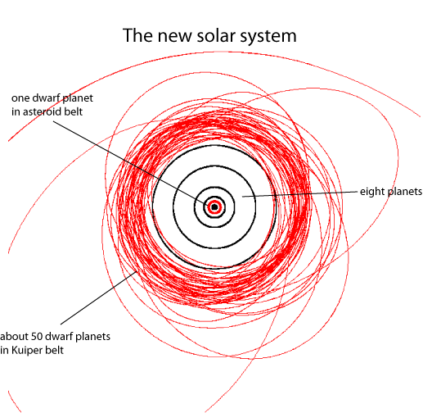
DWARF PLANETS AND KBO’S

Slide 2
In 2008 the International Astronomical Union set up new criteria by which an object could be classified as a planet.
It was the discovery of the object Eris, being hailed as the 10th planet led to a hasty meeting of the IAU in Praque. Eris was measured to be slightly larger than Pluto. At the end of this meeting Pluto & Eris were both demoted to dwarf status.
There are presently 5 dwarf planets: Pluto, Ceres, Eris, Haumea and Makemake, as well as 5 KBO”s (Kuiper Belt Objects): Sedna, Quaoar, Orcus, Ixion, and Varuna. The 5 KBO’s are also being considered for dwarf status.
A planet must:
Orbit the sun
Have enough gravity to be spherical in shape
Clear its orbit of all other bodies and debris

Slide 3
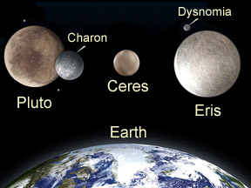

Slide 4
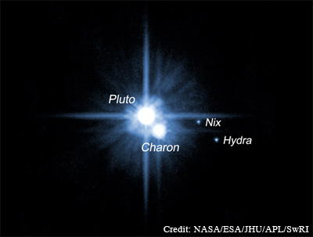
Pluto: Roman god of Underworld
Discovered in 1930 by Clyde Tombaugh.
Diameter: 1430mi ( 2390 km )
Orbital Period: 248 years
Moons: Charon, Nix & Hydra
Surface: Frozen methane, nitrogen and carbon monoxide
Temperature -356 degrees
Pluto and Charon share a unique relationship. Charon is almost ½ the size of Pluto. Both revolve in such a way that the same face of each is always facing the other.
The New Horizons spacecraft is on its way to arrive at Pluto in 2015. It will be the first vehicle to visit the former planet.

Slide 5
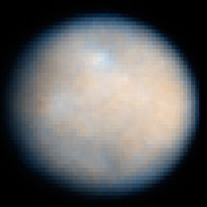
Ceres: Roman goddess of grain
Discovered in 1801 by Giuseppe Piazza
Diameter: 590 mi ( 950 km )
Orbit: 4.6 years
Moons: none
Surface: Rocky and barren
Ceres is the largest object in the asteroid belt between Mars and Jupiter. It makes up about 1/3 the total mass of the asteroid belt.
Ceres like Pluto was also considered a planet for a short time in the 1800’s.

Slide 6
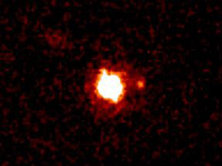
Eris: Goddess of warfare and strife
Discovered: 2005
Orbit: 557 years
Diameter: 1553 mi ( 2500 km )
Moons: Dysnomia
Surface: Thought to be similar to Pluto. Its distance ( 3X that of Pluto ) is too far for definite measurements.
In mythology Eris was known for stirring up jealousy and Envy to cause fighting amongst men. Enraged at not being invited to the wedding of the parents of Achilles, she started a quarrel amongst the gods that led to the Trojan War.
Dysomia is the daughter of Eris and the demon spirit of lawlessness.

Slide 7
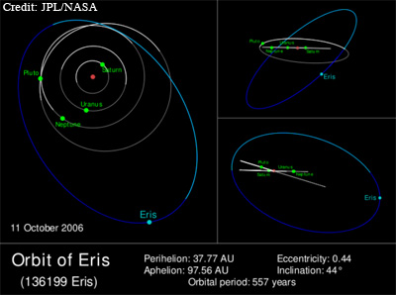

Slide 8
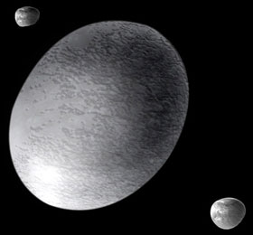
Haumea: Hawaiian goddess of fertility and childbirth
Discovered: 2003
Diameter: 1218 mi ( 1960 km )
Orbit: 285 years
Moons: Hi’iaka and Namaka her children
Surface: Frozen gases
Haumea rotates in about 4 hours. This fast rotation may be the reason for its oval shape.

Slide 9
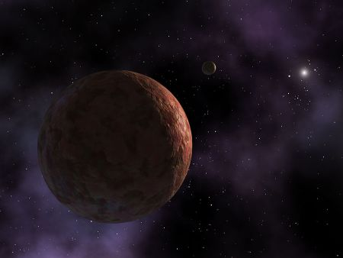
Makemake: god of fertility and maker of humans. A Rapa Nu god from Easter Island
Discovered: 2005
Orbit: 310 years
Diameter: 808mi (1300km)
Moons: none
Surface: unknown but does have a reddish color.
Was named for an Easter Island god because it was discovered on the day after Easter.

Slide 10
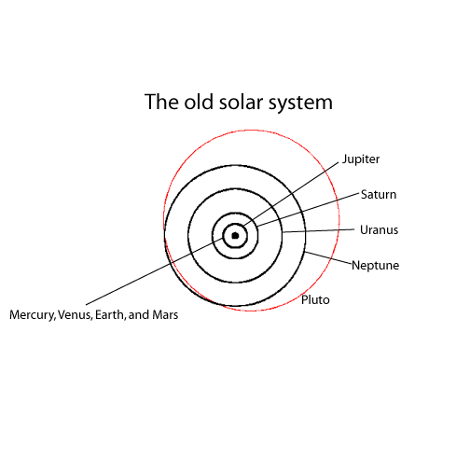

Slide 11
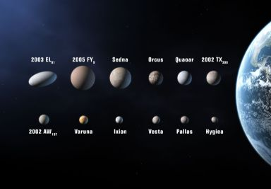
KBO’s (Kuiper Belt Objects) , Dwarf planets and largest Asteroids

Slide 12
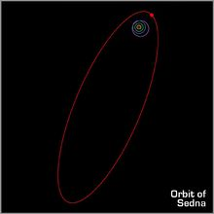
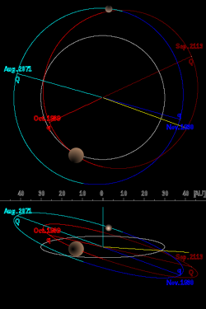
Sedna: Inuit goddess of the sea
Discovered: 2003
Diameter: 995mi ( 1600 km )
Orbit: 10500 years?
Sedna and other 4 KBO’s are being considered for dwarf planet status.
Varuna: Hindu god of the sky
Discovered: 2000
Diameter: 560 mi ( 900 km )
Orbit: 283 years

Slide 13
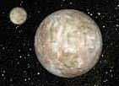
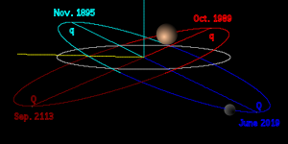
Orcus: The Etruscan god of the underworld
Discovered: 2004
Diameter: 995 mi (1600km)
Orbit: near to 248 yrs.
Moon: Vanath, the Etruscan equal to Charon
Surface: Ices similar to those of Pluto
Orcus is one of over a dozen KBO’s known to have a moon. Its proximity to Pluto’s orbital period is what led to its name.

Slide 14
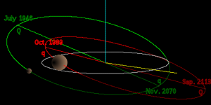
Having an orbit very close to the size and distance of Pluto led to a name dealing with death and the underworld.
Ixion: A minor Greek character who was the first human to have spilled the blood of his kinfolk.
Discovered: 2001
Diameter: 660 mi ( 1000km )
Orbit: 250 years
Moons: none

Slide 15
Quaoar: (kwa-o-whar) God of creation from the Native American Tongva.
Discovered: 2002
Diameter: 745mi ( 1250 km )
Orbit: 285 years
Moons: Weywot – god of sky
Surface: Icy world similar to Pluto
Quaoar is one of the reasons Pluto is not a Planet. Notice the orbit of Quaoar ( red ) with Pluto the outermost blue orbit. Although the orbits do not cross, they occupy similar areas and distance from the sun.

