Slide 1
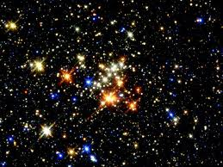
CHARACTERISTICS OF STARS

Slide 2
A star is a ball of gas that gives off a tremendous amount of electromagnetic radiation.
The energy comes from a process called nuclear fusion. In this process light atomic nuclei are fused together to make heavier atomic nuclei.
Most stars in the night sky appear to be tiny specks of white light. However, if you look closely at the stars you will notice that they have different colors. Red, Orange, Yellow, White and Blue can be found as star colors in the night sky.

Slide 3
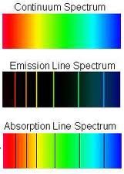
Astronomers learn about stars by analyzing the light that they emit.
Astronomers use an instrument called a spectrograph, which breaks light into colored spectra, to analyze the elements in a star
There are three types of spectra, Continuous, Emission and Absorption.
The absorption, or dark line spectra, is what scientist use to determine the composition of stars.

Slide 4
The surface temperature of a star is indicated by the stars color. Blue stars are the hottest and Red stars are the coolest. Some blue stars can have temperatures as high as 50000° C
Color | Surface Temperature °C | Examples
Blue | Above 30,000 | 10 Lacertae
Blue – White | 10,000 – 30,000 | Rigel, Spica
White | 7,500 – 10,000 | Vega, Sirius
Yellow – White | 6,000 – 7,500 | Canopus, Procyon
Yellow | 5.000 – 6,000 | Sun, Capella
Orange | 3,500 – 5,000 | Arcturus, Aldebaron
Red | Less than 3,500 | Betelguese

Slide 5
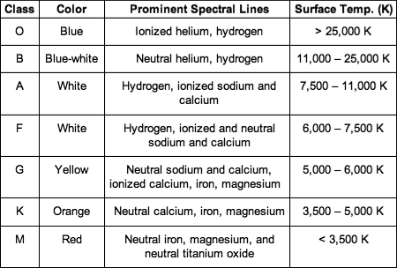
Stars also have a letter classification that corresponds to the color and the elements found in the stars spectrum.

Slide 6
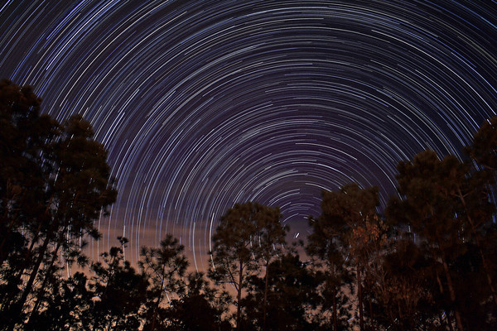
There are two types of stellar motion. Apparent motion shown in the picture is due to Earth’s rotation.

Slide 7
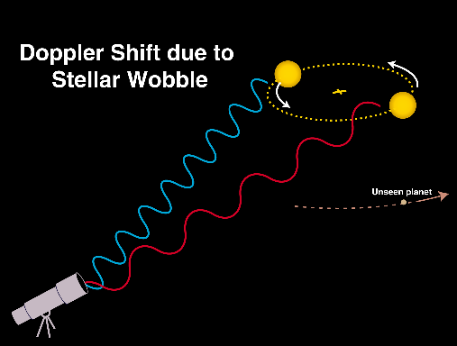
The second motion is actual motion. This motion produces a doppler effect in stars. Stars moving towards earth show a blue shift, while those moving away shift toward the red.

Slide 8
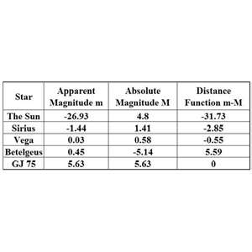
Apparent magnitude is the brightness of a star as we see it from here on earth.
The brighter the star is, the lower the number used for luminosity.
Negative numbers are brighter than positive.
Absolute magnitude is the brightness of a star if all stars were equal distance from the earth.

Slide 9
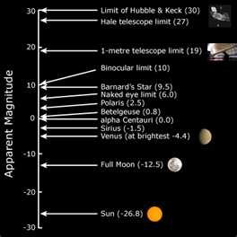

Slide 10
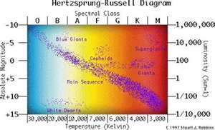
Stars are classified on the H-R diagram according to their luminosity (absolute magnitude) and surface temperature. The graph is named for Ejnar Hertzsprung and Henry Russell, the astronomers who discovered the pattern nearly 100 years ago.

Slide 11
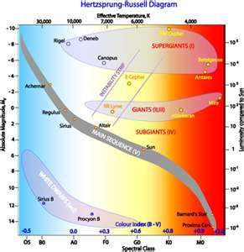
Supergiants
Giants
Main sequence
Dwarfs

Slide 12
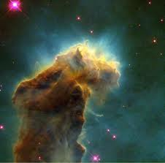
This is the Eagle Nebula. A nebula is a cloud of dust and gas from which stars are born.

Slide 13
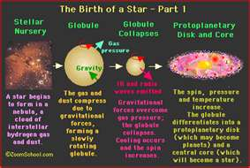

Slide 14
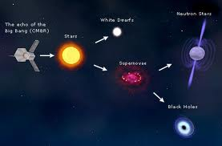
The death of a star depends on the stars original mass. Stars light the sun will expand to a red giant and later become a white dwarf when gravity causes it to collapse.

Slide 15
