Slide 1
VOCABULARY – WEATHER
ADIABATIC COOLING HURRICANE DROUGHT
FRONTAL WEDGING CLOUD FORMATION FLOOD
FLOOD SAFETY CONVERGENCE TORNADO
FRONTAL BOUNDARIES MITIGATION THUNDERSTORM
WARM FRONT STATIONARY FRONT COLD FRONT
OCCLUDED FRONT

Slide 2
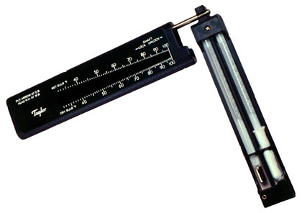
Chapter 23
ATMOSPHERIC MOISTURE

Slide 3
OBJECTIVES
Explain how heat energy affects the changing phases of water
Explain what absolute humidity and relative humidity are, and describe how they are measured.
Describe what happens when the temperature of air decreases to the dew point or below the dew point.

Slide 4
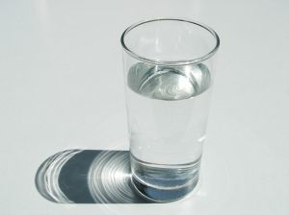
Water changes from one phase to another when heat is absorbed or released.

Slide 5
As energy is absorbed by the ice the molecules move more rapidly .
Molecules of ice are held almost stationary in a definite arrangement
They break their fixed positions, slide past each other and form a liquid

Slide 6
Heat energy that is absorbed and released by an object is called latent heat
As energy is absorbed by the liquid, it will change to a gas.

Slide 7
As energy is lost to the air, the gas will condense back to a liquid.

Slide 8
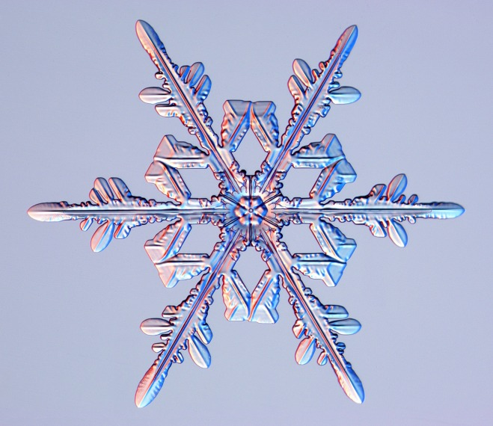
As more energy is released the molecules will move closer together, releasing latent heat and the water freezes.

Slide 9
Humidity is water vapor in the air.
Humidity is controlled by the rate of evaporation and the rate of condensation.
The point where evaporation is equal to the rate of condensation is called the dew point.
At temperatures below the dew point, condensation occurs and liquid water droplets form.

Slide 10
The most common way to express the amount of water vapor in the atmosphere is by relative humidity.
Relative humidity is a ratio of the actual water vapor in the air to the amount of water that air can hold at a given temperature.
For example, at 25° C, air is saturated when it contains 20g of water vapor per 1 kg of air. If air that is 25°C contains 5g of water vapor, the relative humidity is expressed as 5/20 or 25%.

Slide 11
If the temperature does not change, the relative humidity will increase if moisture enters the air.
If the temperature increases the volume of the air will increase.

Slide 12
If the volume of the air increases and moisture remains the same, the humidity will decrease.

Slide 13
When air is nearly saturated with water, only a small drop in temperature is needed for air to reach its dew point
The resulting form of condensation is called dew
During the night, grass, leaves and other objects near the ground lose heat.
The air near the ground reaches its dew point, and water droplets appear on the surfaces

Slide 14
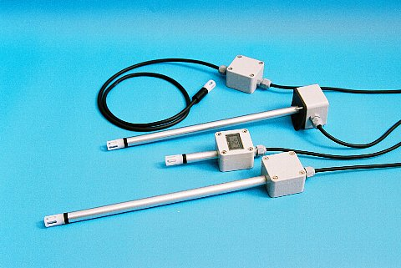
Humidity can be measured by thin polymer film, a psychrometer, a dew cell or hair hygrometer.
Polymer film has the ability to absorb or release water. This ability affects the polymers ability to conduct electricity. By measuring the conductivity of the polymer, relative humidity of the air can be determined.

Slide 15
A psychrometer is another instrument that is used to measure relative humidity.
It consists of two similar thermometers, the bulb of one is covered with a damp wick while the other remains dry
The instrument is waved in the air so that water evaporates off of the wet bulb.

Slide 16
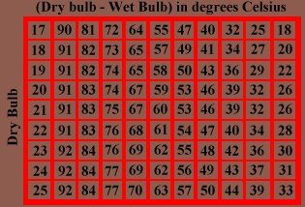
The difference between the dry bulb and wet bulb temperatures is used to determine the relative humidity of the air. If there is no difference between the two, no evaporation occurred, then the relative humidity would be 100%

Slide 17
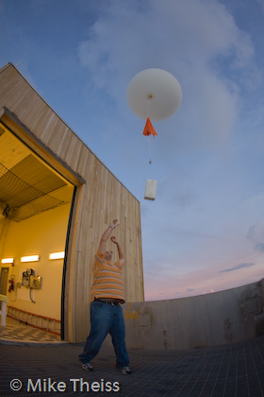
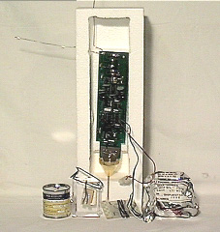
To measure humidity at high altitudes scientist use an instrument package called a radiosonde. It has instruments to measure humidity, temperature, wind speed and direction as well as air pressure.

Slide 18
