Slide 1
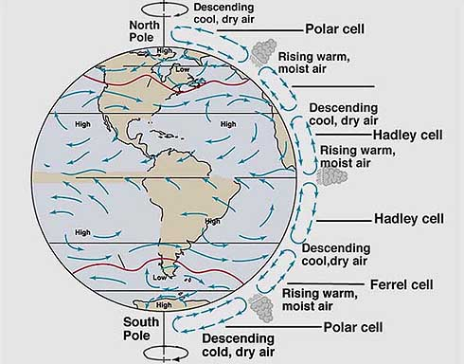
ATMOSPHERIC CIRCULATION
Atmospheric
Circulation

Slide 2
OBJECTIVES
Explain the coriolis effect.
Describe the global patterns of air circulation, and name the three global wind belts
Identify two factors that form local wind patterns

Slide 3
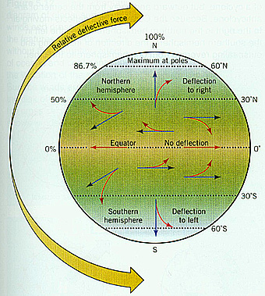
Coriolis Effect
The tendency of a moving object to follow a curved path rather than a straight path because of the earth’s rotation is called the Coriolis effect.

Slide 4
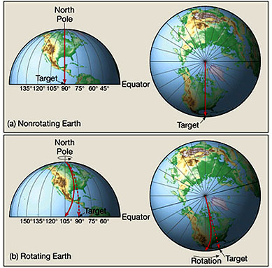
Objects in the northern hemi-sphere are deflected to the right due to the rotation of the earth.
The coriolis effect also changes the path of large masses of air or ocean currents.

Slide 5
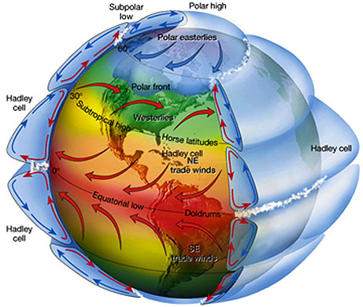

Slide 6
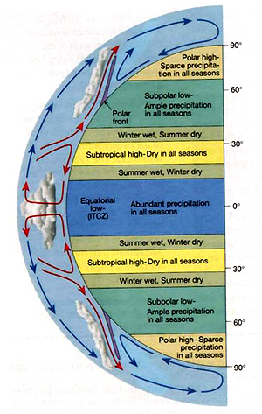
Global wind patterns form three looping patterns of flow called convection cells.
Each cell correlates to an area on earth surface called a wind belt, characterized by winds that flow in one main direction.
These winds are called prevailing winds.

Slide 7
Between 60 and 90 degrees are the polar easterlies
Between 30 and 60 degrees are the westerlies.
Trade winds are winds that blow between 30 and 0 degrees latitude

Slide 8
Here the warm equatorial air moves upward and surface winds are weak, variable and basically non-existant.
Where the northeast trade winds meet the southeast trade winds, a narrow zone called the doldrums occurs.
At 30 degrees of latitude, air is sinking. This forms a high pressure zone called the Horse Latitudes.
At the surface winds are coming downward and again are weak and variable.

Slide 9
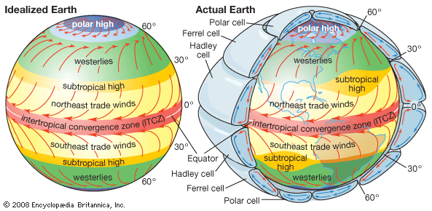
Because of the earth’s tilt, the sun’s rays move north and south on the earth’s surface.
This can cause each of these belts to shift north or south between 10 to 47 degrees.

Slide 10
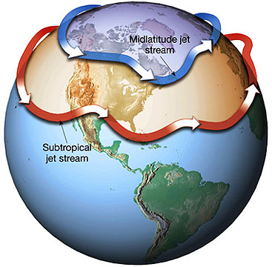
Narrow bands of high speed winds that form in the upper troposphere and lower stratosphere are called JET STREAMS.
Where cold polar air meets with warmer mid-latitude air, a Polar or mid-latitude jet stream occurs.
Where warm tropical air meets cool mid-latitude air, a subtropical jet stream forms.

Slide 11
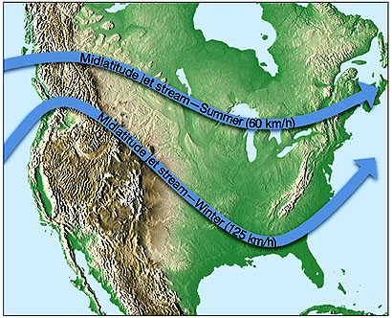
The mid-latitude jet stream can reach speeds up to 500 km/hr. The stream is about 100 km wide and 2 to 3 km thick. They are about 10 to 15 km above the surface.
The mid-latitude jet stream can affect airline traffic and the path of storms.
The subtropical jet stream, changes very little in speed or position.

Slide 12
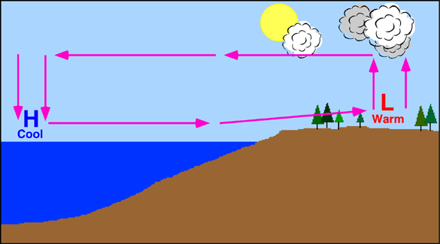
LAND AND SEA BREEZES
Land heats up faster than water. During the day, air over the land heats up and rises creating low pressure. Air moves from the water onto the land to replace the rising air. This creates a local wind called a sea breeze.

Slide 13
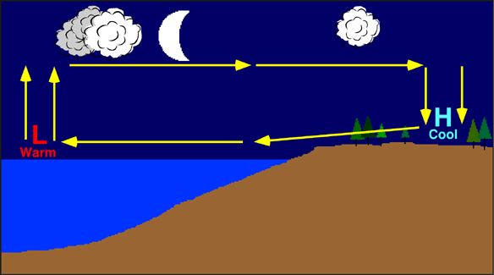
At night, the land cools faster than the water. Air is now rising over the water and sinking over the land. The air now moves off the land to replace the rising air over the water. This local breeze is called a land breeze.

Slide 14
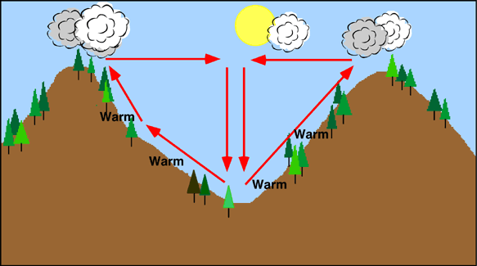
VALLEY AND MOUNTAIN BREEZES
During the day, air in the valley heats up and moves upslope, creating what is called a valley breeze. Winds are named for the direction from which they blow.

Slide 15
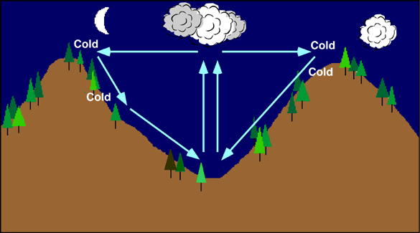
At night, the air in the mountains, which is thinner, cools faster than the air in the valley causing the air to sink and flow down the sides of the valley. This is called a mountain breeze. The sinking air causes the warmer air in the valley to be forced upward, where it condenses forming clouds or fog along the tops of the valley.

