Slide 1
VOCABULARY ATMOSPHERE AND CLIMATE
Greenhouse Gases Global Warming Unequal Heating
Human Industrialization Climate Regional Climate Zone
Global Climate Adaptive Capacity Specific Heat
El Niño Microclimate Climatologist

Slide 2
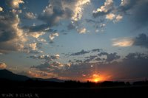
CHARACTERISTICS OF THE
ATMOSPHERE

Slide 3
Characteristics of the Atmosphere
Describe the composition of the Earth’s Atmosphere
Explain how two types of barometers work
Identify the layers of the atmosphere
Identify two effects of air pollution

Slide 4
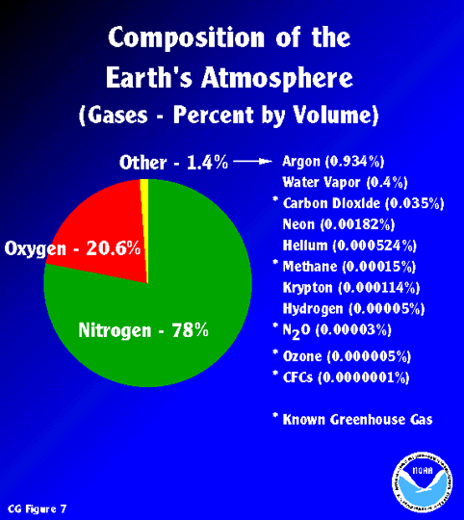

Slide 5
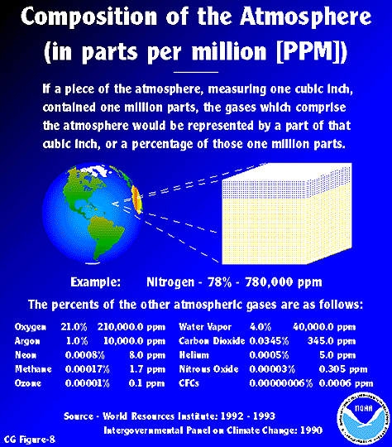

Slide 6
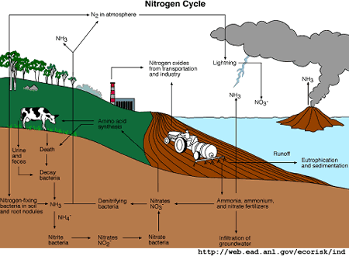

Slide 7
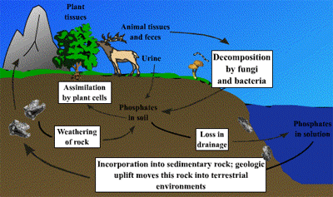
PHOSPHOROUS CYCLE

Slide 8
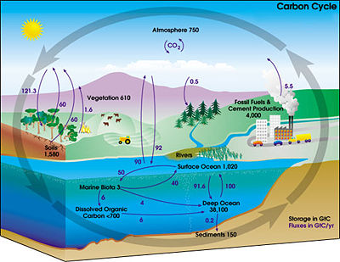

Slide 9
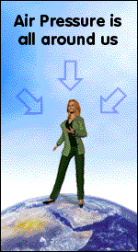
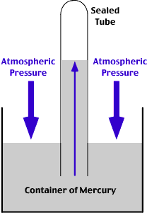
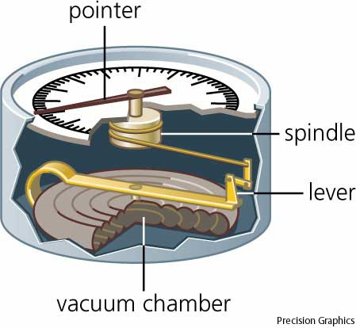
Mercury Barometer
Aneroid Barometer

Slide 10
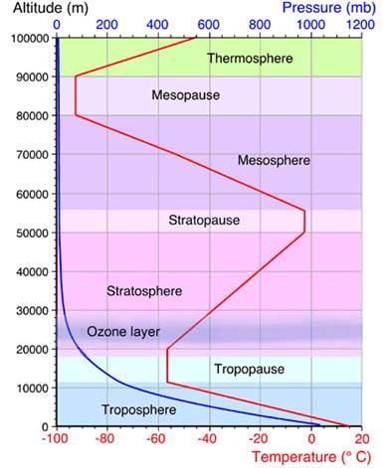
Warmer
Colder
Warmer
Colder

Slide 11
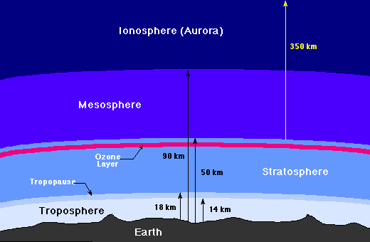

Slide 12
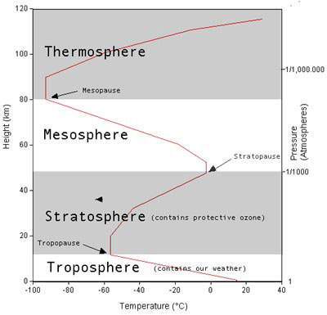

Slide 13
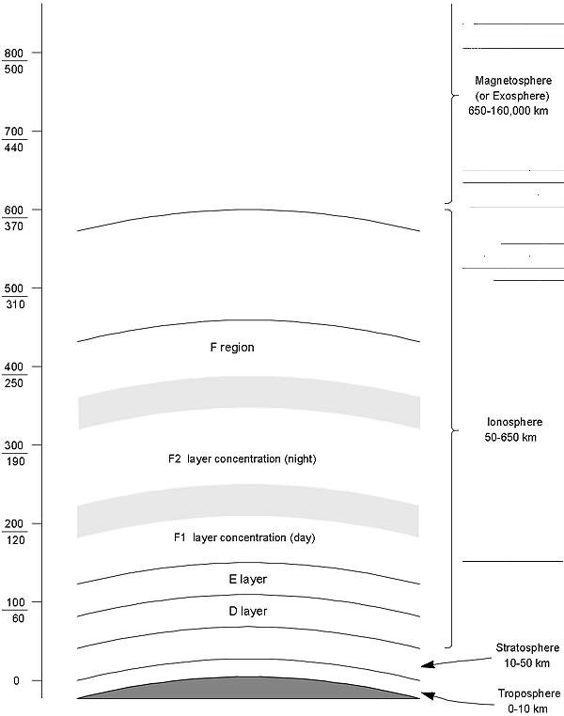

Slide 14
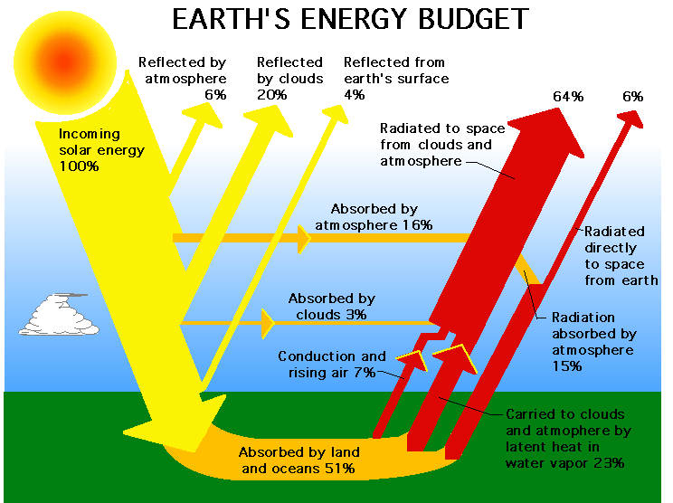

Slide 15
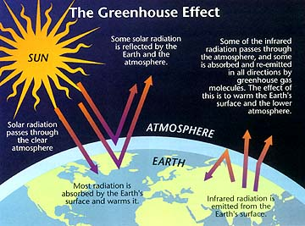

Slide 16
