Slide 1
WEATHER
AIR MASSES
And
FRONTS

Slide 2
OBJECTIVES
Explain how an air mass forms.
List the four main types of air masses.
Describe how air masses affect the weather over North America.
Compare the characteristics weather patterns of cold fronts with those of warm fronts.
Describe how a midlatitude cyclone forms.
Describe the development of hurricanes, thunderstorms and tornadoes.

Slide 3
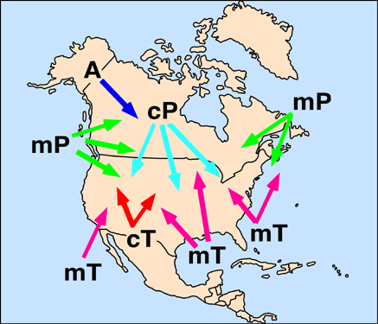

Slide 4
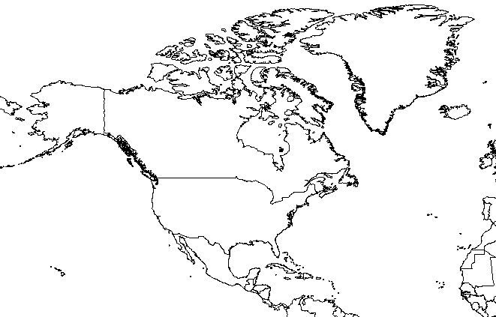
Continental Polar
cP
c = Continental
A continental air mass forms over land and is dry.
P = Polar
A polar air mass is cold

Slide 5
Maritime Polar
m = maritime
A maritime air mass forms over water
mP
mP
Maritime Polar Atlantic
Maritime polar pacific

Slide 6
Continental Tropical
T = tropical means that the air is warm.
Warm dry air
cT

Slide 7
Maritime Tropical
Maritime tropical pacific
Warm moist air
Maritime tropical atlantic
mT
mT

Slide 8
cP air masses bring cold dry air out of Canada.
mP air masses bring moist cold air from north atlantic and north pacific oceans. In winter bring snow and rain. In the summer cool, foggy weather.
cT air masses bring hot and dry weather to the southwestern U.S.
mT air masses bring large amounts of moisture. In the summer the atlantic air mass can bring thunderstorms and hurricanes. The Pacific air masses does not reach the coast in the summer, but in the winter bring moderate precipitation to the southwest.

Slide 9
A front marks the boundary between two air masses. Fronts are named according to which air mass is doing the pushing.
There are 4 basic types of fronts
Cold Front – this occurs when a cold air mass overtakes a warm air mass. The cold air will push the warm air up and over the cold air. If this happens quickly, violent storms can occur such as thunderstorms and tornadoes.
Warm Front – this occurs when warm air slowly overtakes a cold air mass and gently moves over top. This will produce a precipitation over a large area and may sometimes produce violent storms.

Slide 10
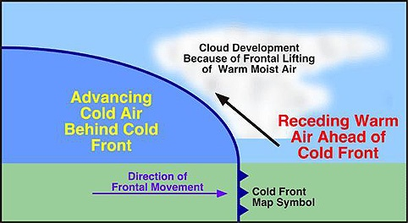
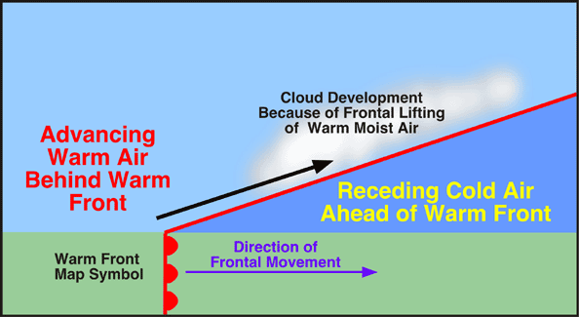

Slide 11
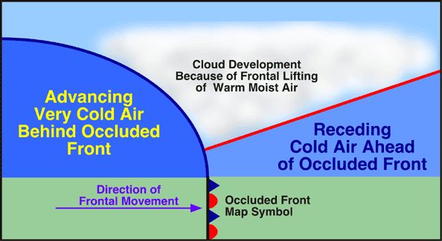
Occluded front – this occurs in the same way as a cold front except the cold air mass completely lifts the warm air mass off the ground and meets a second cold air mass.

Slide 12
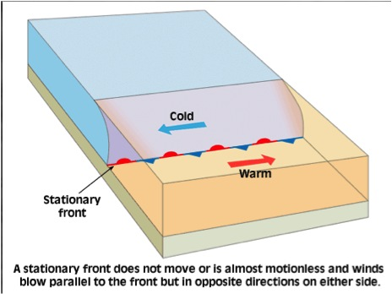
Stationary front – this occurs when a cold air mass and a warm air mass meet head on and neither can push the other out of the way. The weather is usually similar to a warm front.

Slide 13
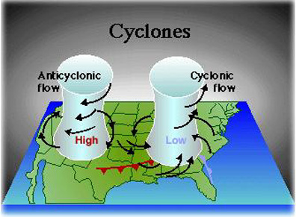
Air in the northern hemisphere moves either counterclockwise, a cyclone, or clockwise, an anticyclone.

Slide 14
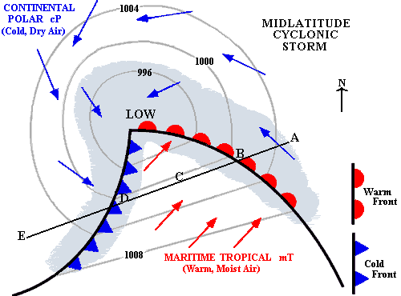
A midlatitude cyclone is a low pressure region where air moves clockwise and inward into the low pressure. Air at the center is warm and rising.

Slide 15
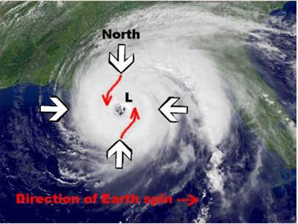
A hurricane is a cyclone. Air is rushing into the center where it rises.

Slide 16
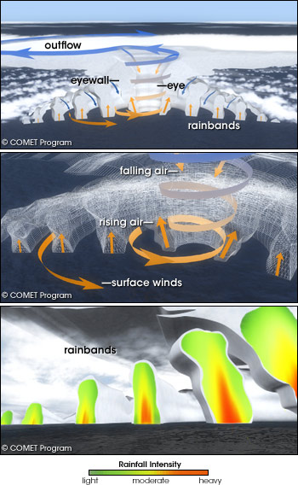
Air rises at the eye and is replaced by air rushing in from the sides.
Air sinks in the eyes center creating clear sky and quiet conditions
Rain bands form where warm moist air rises inside the storm. Latent heat released by the condensing air fuels the storm.

Slide 17
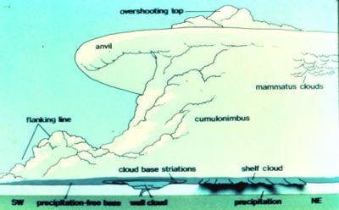
Thunderstorm - Supercell

Slide 18
